Slide 2
Agenda
Dynamic Network Gephi
Graph building
Extracting Seeds from the large graph
Procurement and Travel channels
Extracted graphs

Slide 3
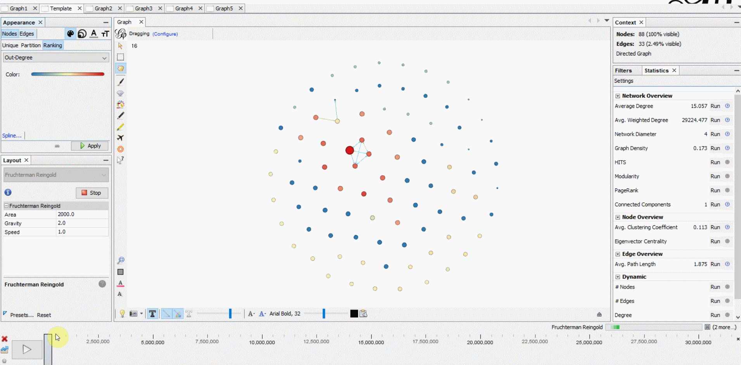
Dynamic Network in Gephi
Graph over time
Interactive
Notes:
Interactive
Filter
Time
Color, size, edge color
Graph Measurements: from number of nodes and edges to graph density, PageRank and so on
Comparing graphs
Layout

Slide 4

Graph building
d
Notes:
Seeds
Four major steps to create graphs
Step 1: Locating the Seed
Step 2: Finding directly connected nodes
Step 3: Accumulating the prominent nodes
Step 4: Finalizing the network.

Slide 5
Extracting Seeds from the large graph
Channel Visualization and analysis
Choosing appropriate channels

Slide 6
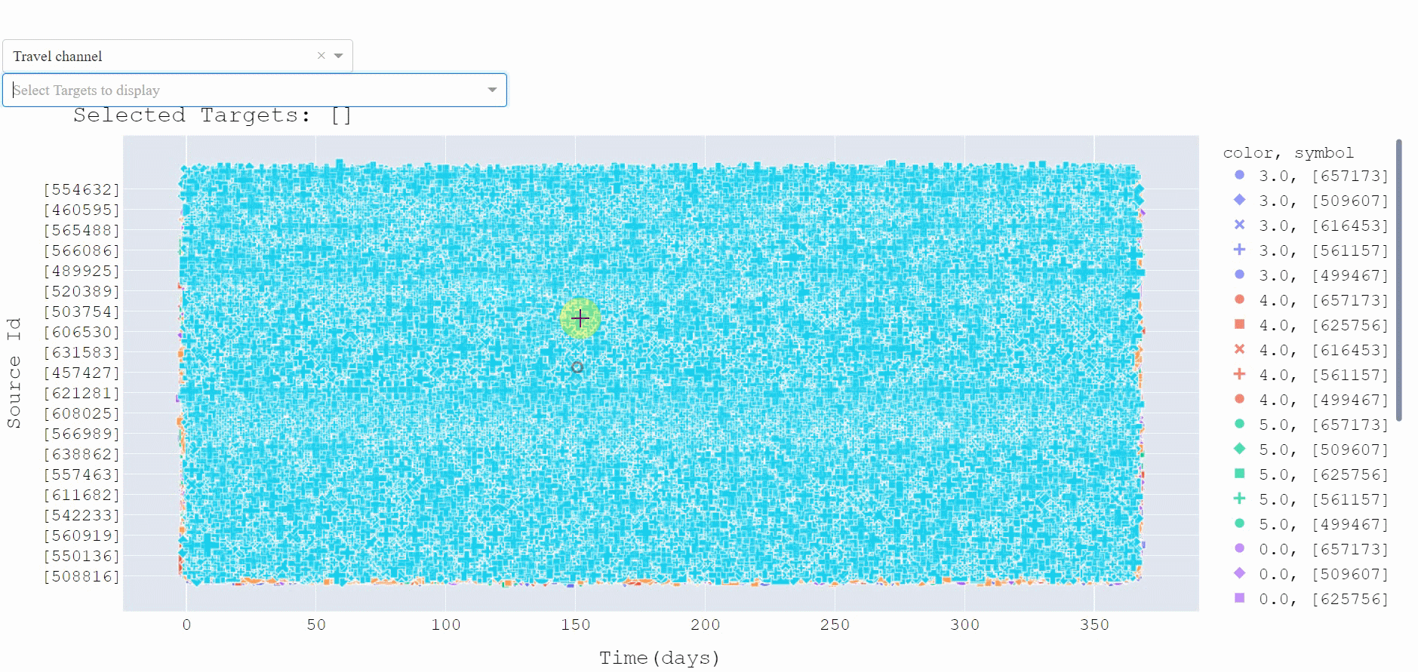
d

